Slide 1
Accessibility 101
Erissa Duvall

Slide 2


Agenda
Basic Terms
Legalities & Guidelines
Experience & User Feedback
Consistent Experience
Keyboards & Screen Readers
Structure & Relationships
Tools & Resources
Erissa

Slide 3

Disclaimer
I’ll pull from my professional experience, but am not officially representing any of my previous, former, or future employers.
I may mention aspects of legislation / regulations but am not an attorney / solicitor.
Erissa
Notes:
“Keep Calm and CYA” image was sourced from CYA is Killing Your Organization. I recently started working with an… | by Jennifer Cross | It's Your Turn (itsyourturnblog.com)
Image Source URL: https://itsyourturnblog.com/cya-is-killing-your-organization-c2a17e15d834

Slide 4

Ask questions!
Raise your hand or type a question in chat.
I am in the Code Louisville Slack, which also has an Accessibility channel.
I will also have links to resources at the end of the presentation.
Erissa
Notes:
“Keep Calm and CYA” image was sourced from CYA is Killing Your Organization. I recently started working with an… | by Jennifer Cross | It's Your Turn (itsyourturnblog.com)
Image Source URL: https://itsyourturnblog.com/cya-is-killing-your-organization-c2a17e15d834

Slide 5
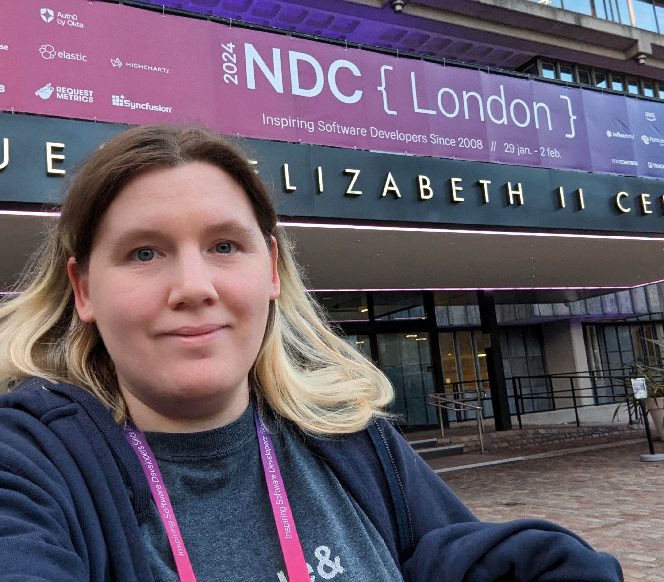
My Background
Spina Bifida, Scoliosis, and effectively a chapter out of the DSM-5.
DHS Trusted Tester
American Printing House for the Blind
GoodMaps
Accessibility Engineer
International Speaker
Erissa

Slide 6
Basic Terms
Accessibility / A11Y
Disability & Social Model
Assistive / Adaptive Technology (AT)
Erissa

Slide 7
Legalities / Guidelines
WCAG & ISO
Section 508 or ADA
PDF/UA
Erissa

Slide 8
Experience & User Feedback
Erissa

Slide 9


Experience & User Feedback Continued
Erissa

Slide 10
Consistent Experience
POUR Principles
Keyboard & Screen Reader
Erissa

Slide 11
Structure & Relationships
Semantics
Landmarks
Best Practices
First rule of ARIA
Erissa

Slide 12
Tools
Bookmarklets
Extensions
Desktop Applications
Erissa

Slide 13

Accessibility Overlays
Check out https://overlayfactsheet.com/!
Decline

Slide 14

Thank you!
Erissa Duvall
www.Corgidev.com
linktr.ee/corgidev
Erissa

